Slide 1


Python
Presenta:
Dr. Fernando Javier Alcántara López
Licenciatura en Neurociencias

Slide 2
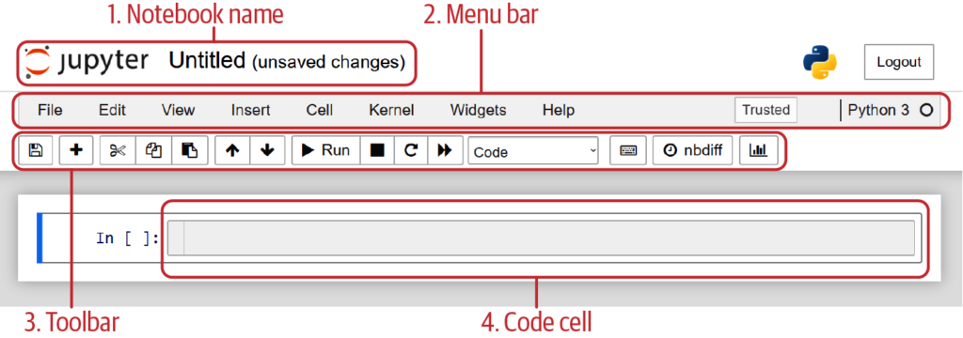
Jupyter

Slide 3
Ver Markdown en pycharm

Slide 4
Data types in python
Data Types | Classes | Description
Numeric | int, float, complex | holds numeric values
String | str | holds sequence of characters
Sequence | list, tuple, range | holds collection of items
Mapping | dict | holds data in key-value pair form
Boolean | bool | holds either True or False
Set | set, frozeenset | hold collection of unique items

Slide 5
Características de las estructuras de datos
Indexado
Ordenamiento
Mutable
Duplicados

